Slide 1
JSON
POST Method
Presenter - Kumari Kusum
MST01-0076
Mentor – Farzana Rashid

Slide 2
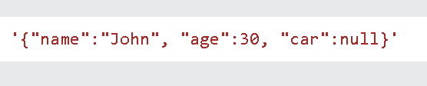
JSON
stands for JavaScript Object Notation
used when data is sent from a server to a web page
The file type for JSON files is ".json"
The MIME type for JSON text is "application/json"
JSON Syntax Rules
Data is in name/value pairs
Data is separated by commas
Curly braces hold objects
Square brackets hold arrays

Slide 3
Post ()
sends a POST request to the specified url.
used when you want to send some data to the server.
The requests module allows you to send HTTP requests using Python.
The HTTP request returns a Response Object with all the response data (content, encoding, status, etc)
How it works:
A client (e.g., a web browser, mobile app, or server) initiates a POST request to a server.
The client includes a JSON payload in the request body, which contains the data to be sent to the server.
The server receives the request and processes the JSON data.
The server returns a response to the client, which may include data, errors, or other information.

Slide 4


Syntax
requests.post(url, data={key: value}, json={key: value}, args)
Parameter Values
url - Required. The url of the request
data - Optional. A dictionary, list of tuples, bytes or a file object to send to the specified url
json - Optional. A JSON object to send to the specified url

Slide 5
Post Vs Get
POST is more secure than GET because user entered information is never visible in the URL query string or in the server logs.
There is a much larger limit on the amount of data that can
be passed and one can send text data as well as binary data (uploading a file) using POST.
reallyygreatsite.com

Slide 6
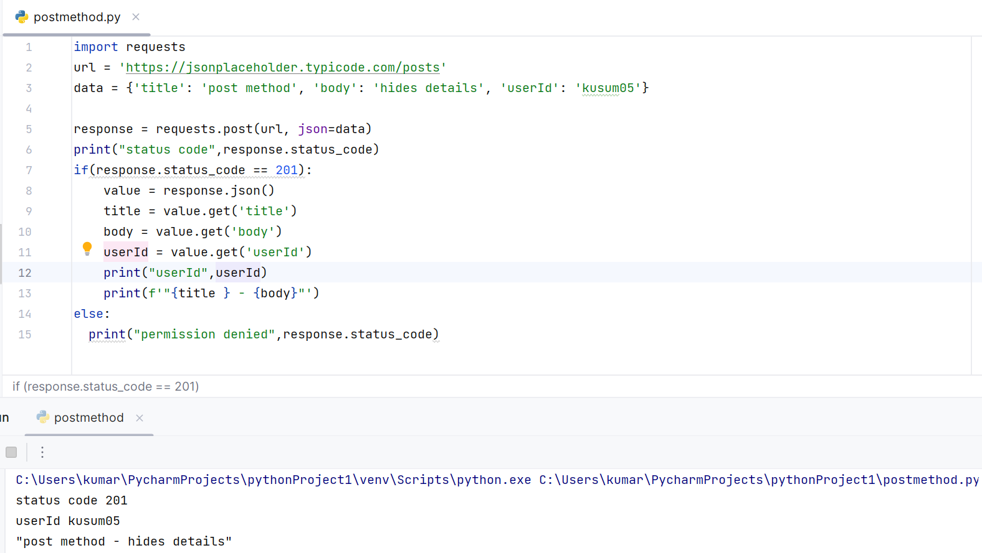
Implementation
URL: https://jsonplaceholder.typicode.com/posts

Slide 7
Thank You

